Slide 1
Balanced Scorecard
Management of ICT

Slide 2
Balanced Scorecard
It is a performance measurement framework that added strategic non-financial performance measures to traditional financial metrics to give managers and executives a more 'balanced' view of organizational performance.

Slide 3
What is it?
A strategic planning and management system to:
Aligns business activities to the vision and strategy of the organization
Helps planners identify what should be done and measured.
Enables executives to execute their strategies.
Improves internal and external communications, and
Monitors organization performance against strategic goals.

Slide 4
BSC Strategic Dimensions
The Learning & Growth Perspective
Human capital, Information capital, Organization capital, knowledge management
The Business Process Perspective
Operations, service, innovation
The Customer Perspective
Operational excellence, product leadership, customer relationship
The Financial Perspective
Revenue growth, productivity, increasing shareholder value

Slide 5
Stakeholder Perspective
Stakeholders perspective | Key questions
Board of Directors Executive Management Committee | What value does ICT add? Does ICT enable or retard growth? Does ICT stimulate organisational innovation and learning? Is ICT well managed?
Line of Business Management Customer | Are our ICT investments profitable? How does ICT affect the customer’s experience? Does ICT improve productivity? Does ICT put us in a position to meet future market demands?
Risk Management and Regulatory Management | Are the organisation’s assets and operations protected (incl privacy)? Are the key business and technology risks being managed? Are the proper processes and controls in place? Are we doing the right things?
ICT Organisation | Are we effectively managing our service and technology providers? What do we need to improve to meet our objectives? Have we satisfied all key stakeholder interests? Are we able to attract/retain the talent we need?

Slide 6
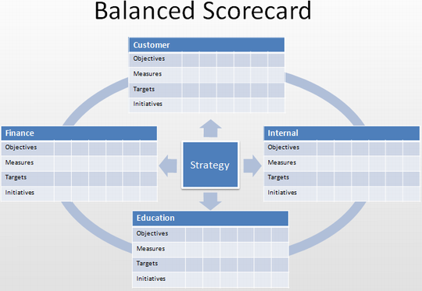
BSC model (Norton and Kaplan)

Slide 7
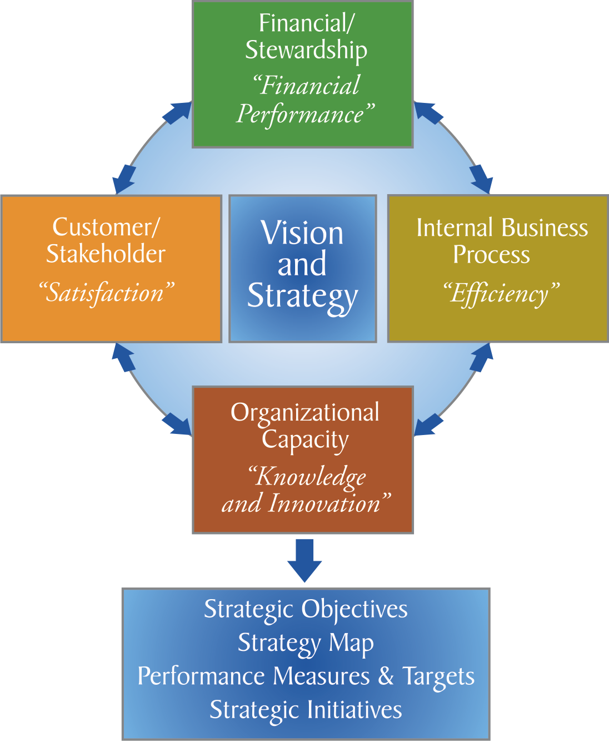
A modified BSC Model

Slide 8
Strategy Mapping
Lower Cost
Increase Profitability
Increase Revenue
Financial
Leading Question – How?
Lower Wait Time
Improve Customer Satisfaction
Customer
Increase Process Efficiency
Lower Cycle Time
Internal Process
Leading Question – If.. Then?
Organisational Capacity
Improve Knowledge & Skills
Improve Tools and Technology

Slide 9
BSC should:
Measure performance against goals
Determine if the goals are appropriate
Determine if the strategy or measures should be changed
Provide direct measurable outcomes traceable to the actions of individuals and teams
Have scalar units of measure: dollars, defects/1000, percentiles, etc.
Have metrics for quality, response time, budget compliance
Have independent variables that can be controlled which are connected to the dependent variables.
Source: G.B. Alleman (2003), BSC Conference.

Slide 10
Four elements of IT Strategy
Organizational Strategy – WHY
The wherefore and rationale for the strategy
Organizational components – chose the structure or design, management control systems and formal policies.
Business Components – the corporate strategy concerned with mission. Strategic business unit strategy concerned with competitive advantage
Information Technology Strategy – HOW
The mechanism of the strategy
Scope – which technologies are to be formally included in the information strategy
Architecture – the technology framework which drives, shapes, and control the Information technology strategy.
Information Systems Strategy – WHAT
The components of the strategy
Alignment – identify the applications required to support the business strategy
Opportunity – search for innovative uses of IT to enable business to perform better
Information Management Strategy – WHO
The participants in the strategy
Roles – who has what responsibility for information resources and policies and actions
Relationships – how are relationships built between the CIO and others to assure success over time
Source: G.B. Alleman(2003), BSC Conference.

Slide 11
Portfolio Management
Portfolio Management
Need Identification
Evaluation
Selection
Timing

